Slide 1
Sales
Analysis
For
Kuramo Superstores

Slide 2
Agenda
Problem Statement
Process Outline
Insights Uncovered
Summary

Slide 3
Problem Statement
Kuramo Superstore opened three (3) new outlets across town and is interested in knowing how their business has fared financially in the first three (3) months of operations.
They are also interested in classifying their customers based on demography. This is expected to aid retargeting and knowledge of items to restock.
They also want to know the most profitable store per month, business peak hour and if the introduction of membership cards has influenced purchases in any way.

Slide 4
Process Outline
1
Data Understanding
2
Data Cleaning
3
Data Modelling
4
Analysis
5
Uncovering Insights

Slide 5
Insights
Prime Time
Kuramo Superstores collectively make the most profit and have the most traffic at 7 pm. It certainly is the Superstore’s Prime Time. Although one can see that traffic surges between 1pm & 3pm, it doesn’t compare with 7pm.
From the analysis, the time differs monthly. In January, it was 1 pm, February was 3 pm and March was 7 pm.
Mandalay’s Prime Time is 7 pm, the same as Naypyitaw. Yangon has hers as 3 pm, closely followed by 7 pm.
7pm

Slide 6
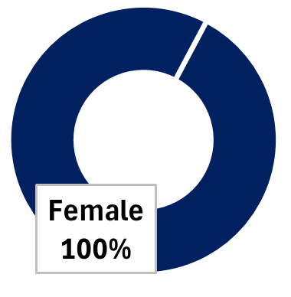
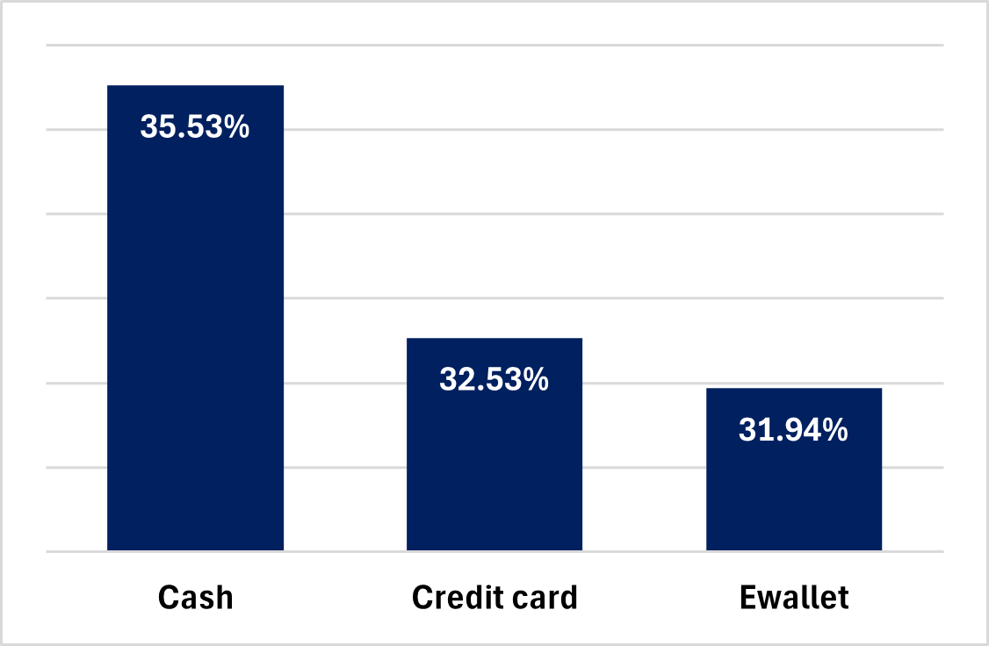
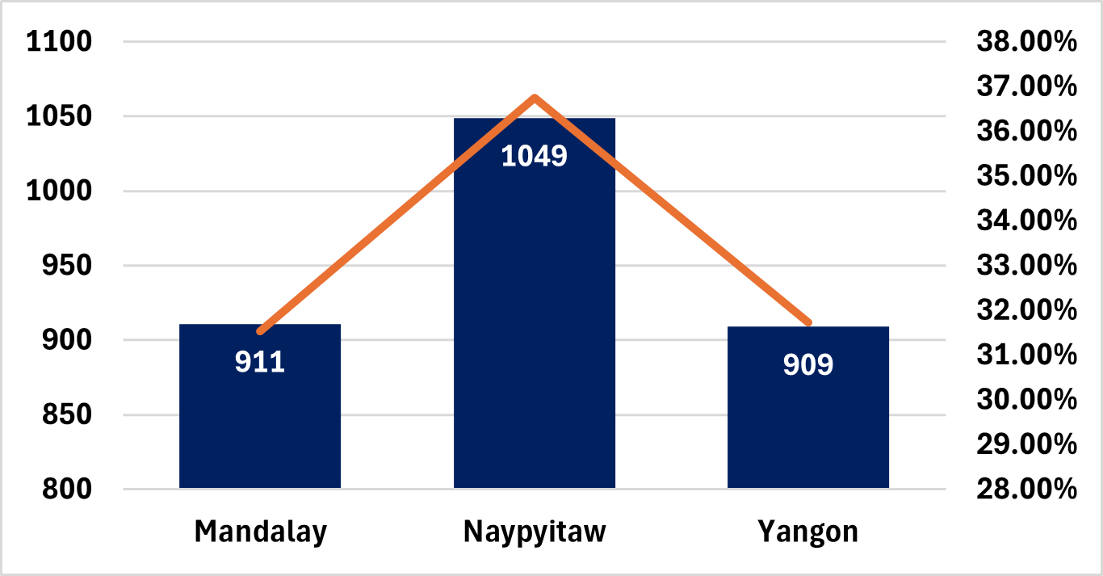
Insights
Women
Women are the heaviest spenders in Kuramo stores.
They picked 2,869 units of items and brought in $7,994.43 into the purse of the business.
Most of them are fans of the membership card as 52.10% already shop with it in the various stores. They Prefer to shop at 1pm, spending cash as against credit card or E.Wallet.
Naypyitaw is the city with the most women shoppers, and they are delighted with the service experience.

Slide 7
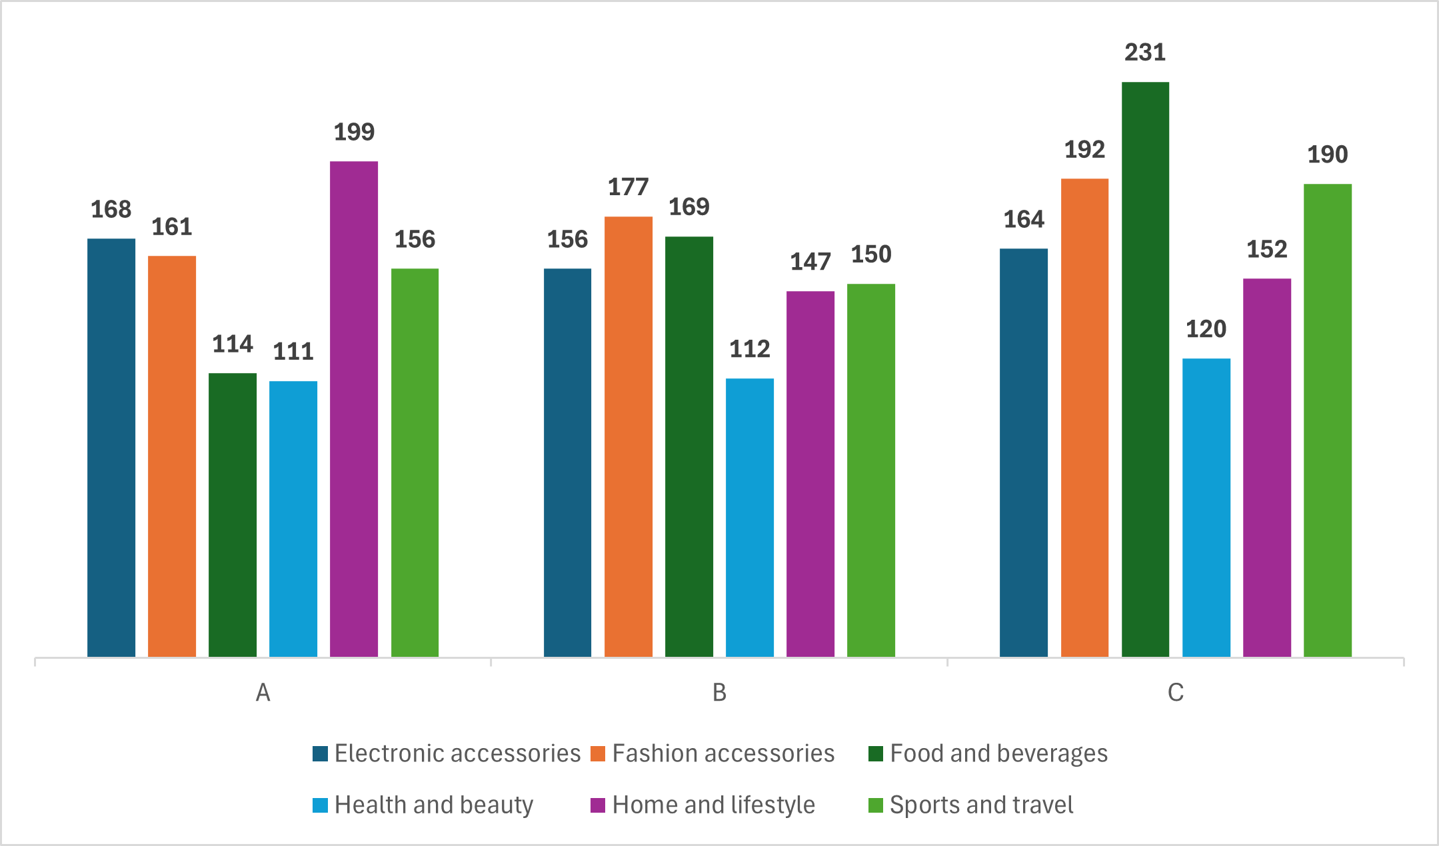
Insights
What are WOMEN buying?
Most items women buy vary from the stores.
They bought Home & lifestyle items from Branch A (Yangon), Fashion & Accessories items from Branch B (Mandalay), and Food & Beverage items from Branch C (Naypyitaw).

Slide 8
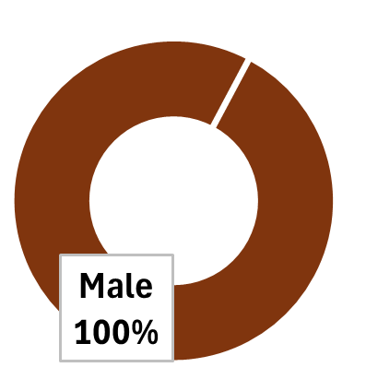
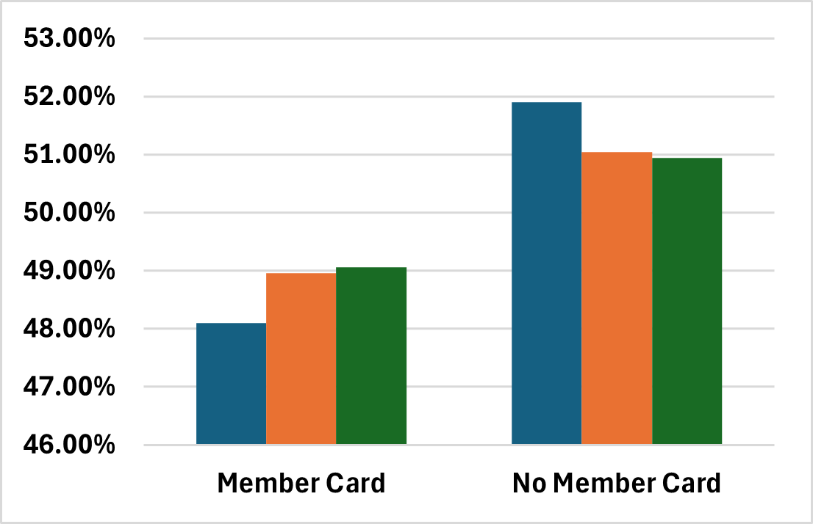
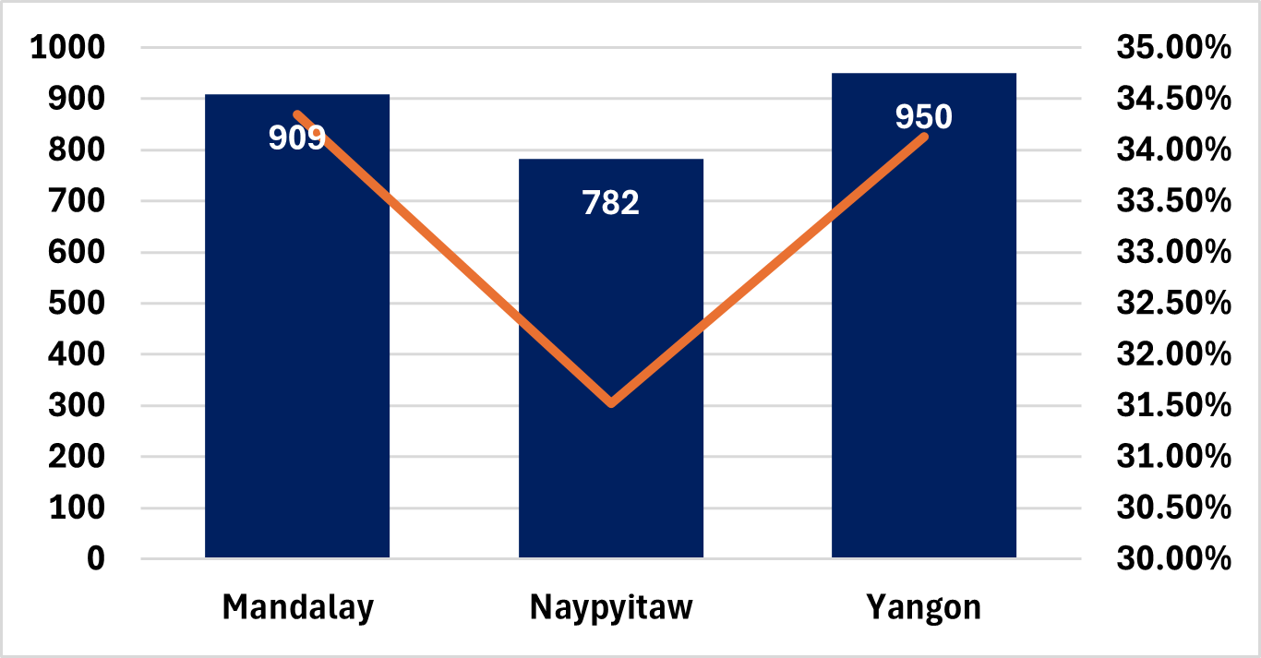
Insights
Men
Men collectively bought 2,641 items, pushing $7,384.94 into the purse of the business.
Most do not fancy the membership card as only 48.1% shop with it in our various stores. They Prefer to shop at 7pm, and pay with E.Wallet instead of spending cash or credit card
Insights gathered on the gender will give a clear direction on targeting them with specialised adverts or promotions across the stores.
It would also help with the restocking of selected items.

Slide 9
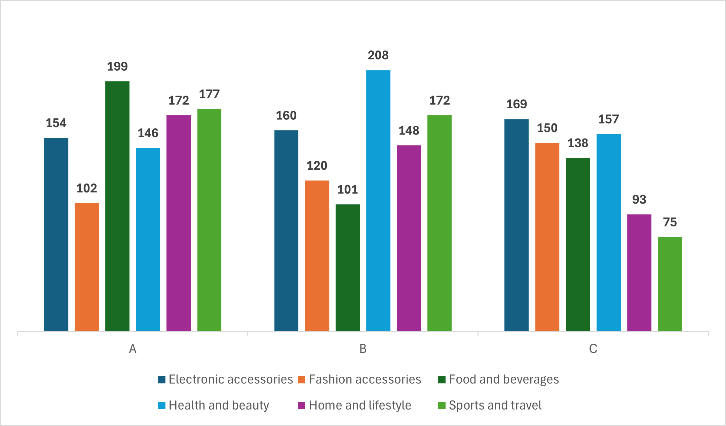
Insights
What are MEN buying?
Most items men buy vary from the stores.
They bought Food & beverages from Branch A, Health & Beauty from Branch B and Electronic Accessories from Branch C.

Slide 10
Insights
for January
Branch
A
(Yangon)
685
Branch A sold the highest unit of items (685)
1965
units
1965 units of items were collectively sold by all branches across town
Generating a net income of $5,537.71 for Kuramo Superstore, the highest across all months analysed for the store.
5,537.71

Slide 11
Insights
for January
Branch
A
685
Highest
Selling
Item
Sports
&
Travel
1965
units
375
units
5,537.71
Branch A (Yangon)
Branch B (Mandalay)
Branch C (Naypyitaw)
Home & Lifestyle
Electronics Accessories
Sports & travel
175 Units
119 Units
144 Units

Slide 12
Insights
for February
Branch
B
(Mandalay)
624
Branch B sold the highest unit of items (624)
1654
units
1654 units of items were collectively sold by all branches across town
Generating a net income of $4,629.49 for Kuramo Superstore
4,629.49

Slide 13
Insights
for February
Branch
A
685
Highest
Selling
Item
Food
&
Beverage
1965
units
349
units
5,537.71
Branch A (Yangon)
Branch B (Mandalay)
Branch C (Naypyitaw)
Food & Beverage
Electronics Accessories & Fashion Accessories
Food & Beverage
127 Units
118 Units
115 Units

Slide 14
Insights
for March
Branch
A
(Yangon)
681
Branch A sold the highest unit of items (681)
1891
units
1891 units of items were collectively sold by all branches across town
Generating a net income of $5,212 for Kuramo Superstore
5,212

Slide 15
Insights
for March
Branch
A
685
Highest
Selling
Item
Home
&
Lifestyle
1965
units
364
units
5,537.71
Branch A (Yangon)
Branch B (Mandalay)
Branch C (Naypyitaw)
Sports & Travel
Home & Lifestyle
Electronic Accessories
139 Units
139 Units
130 Units

Slide 16
Summary
From the analysis, it was interesting to note that men spent the most on health and beauty – this may be because gym products and medication is also shelved under this label, however, that was not expected at all.
Also the most sold or most popular product line was the Electronic Accessories, it had the highest count of sales overall with its highest in Naypyitaw.
They also want to know the most profitable store per month, business peak hour and if the introduction of membership cards has influenced purchases in any way.

Slide 17
Recommendations
To maximise profit, the superstore should ensure sufficient stock of electronic accessories.
Health and beauty-related adverts should be tailored to men, having observed that they spend more on procuring the products, while Fashion accessories should be targeted at women.
The mall sees an influx of customers between 12 pm to 4 pm, however, 7pm is sacrosanct as that is the mall peak hour. While the earlier hours tend to have more women, 7pm tends to have more men. Display Ads across the mall should deliberately push adverts that will be of interest to each gender at their peak time, and additional staff should be available at those times to ensure smooth customer service while promoting customer satisfaction.

Slide 18
Branch
A
685
Thank you
1965
units
Sports & Travel
Home & Lifestyle

